Slide 1




PYTHON in dynamo
PRAGATHEESH KUMAR

Slide 2

Python in dynamo
Explain The Boiler Plate
Explain each common piece of the boiler plate
Show how to build your Python ‘starter’ template
How Dynamo interact with Python
What is Revit API

Slide 3

How does Dynamo interreact with Python?

Slide 4


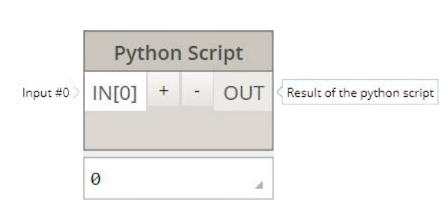
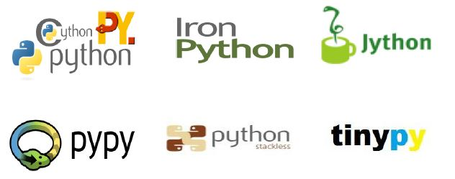
Python Node
Basic Editor/Integrated Developer Environment

Slide 5
Iron Python | .NET Compatible
Interpreted Programming Language (no need to compile)
Communicates with Revit API
IronPython 2.7.3 installed with Dynamo
.NET capabilities (i.e. Revit API)
Iron Python this is the python that is compatible with using C#

Slide 6
.NET Programming language is a platform that has multiple implementation with different programming language
.NET Framework
Autodesk
C#
J#
AutoCAD
Revit
IronPython is a Python that is capable of dealing with the libraries of .NET i.e C# libraries, to be specific Revit API is a C# library

Slide 7

Difference between C# and .Net
C# is a programming language and .NET is a framework.
.NET has Common Language Runtime (CLR), which is a virtual component of .NET framework.
.NET not only has C#, but through it, you can work with VB, F#, etc.
What Does .NET Framework (.NET) Mean?
The .NET framework is a software development framework from Microsoft. It provides a controlled programming environment where software can be developed, installed and executed on Windows-based operating systems.

Slide 8
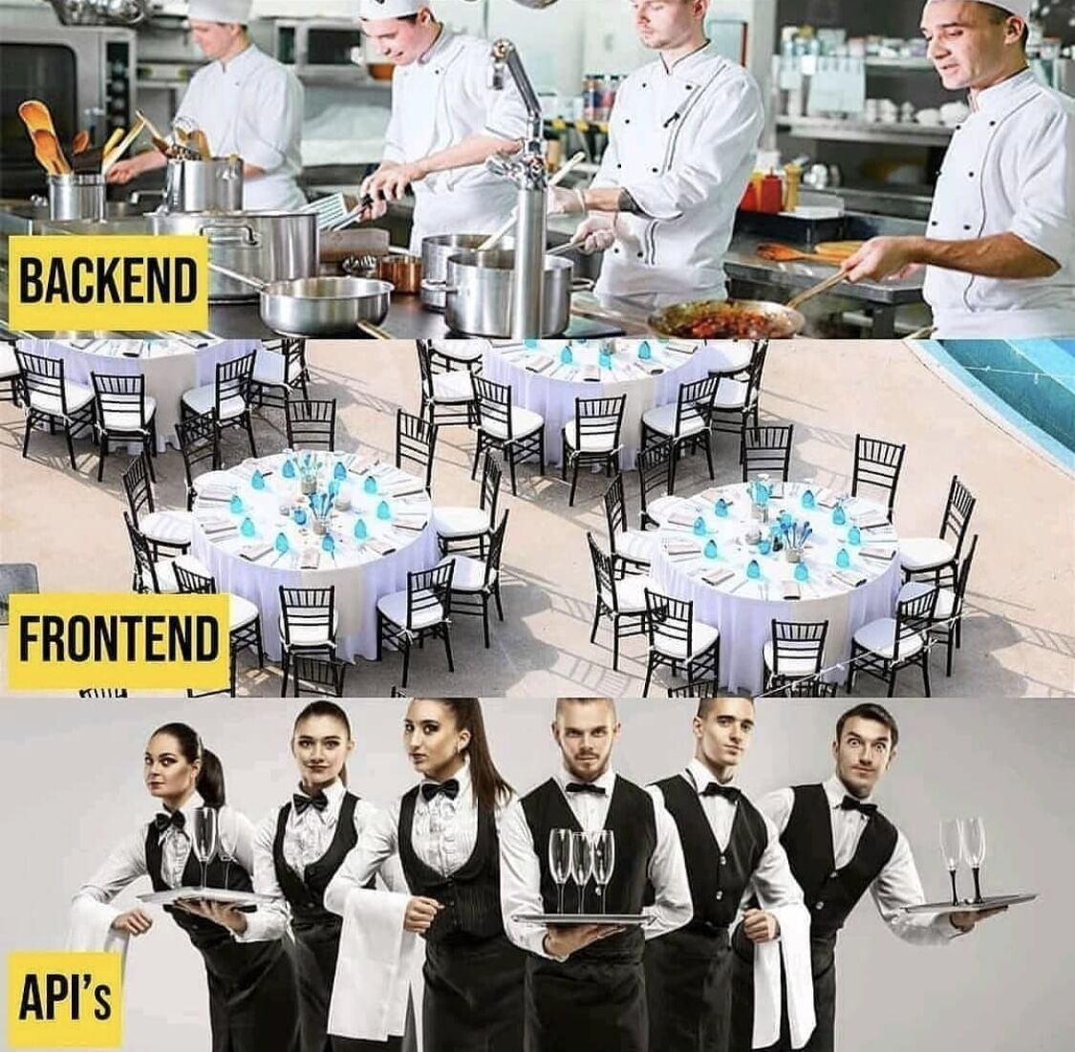
What is an api?
“Application Programming Interface”
List of commands/functions you can give Revit
The MENU to the restaurant’s Kitchen

Slide 9
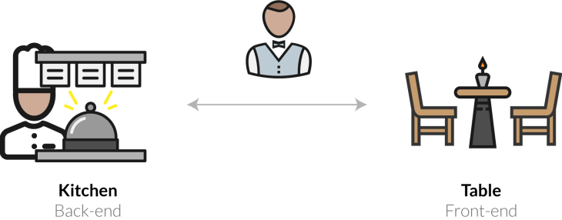
Revit
“The Kitchen”
Our custom application
“The customer”
Place order
API
“Menu”
“Waiter”
Results

Slide 10
Dynamo and Python
The boiler plate

Slide 11
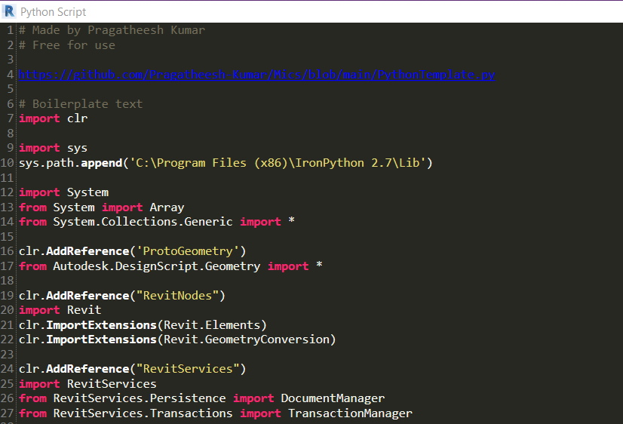
What is a boiler plate?
The Boiler plate is essentially all the beginner text in the script when you write in python.

Slide 12
# comments with a hashtag
import Namespace
from Namespace import*
from Namespace import thing
Syntax
import

Slide 13



CONCEPT
NAMESPACE
A namespace is an abstract container to collect a logical grouping of unique names (identifiers), where that name is identifier only with it’s namespace.
IRON MAN
CAPTAIN AMERICA
Marvel ( Namespace )
Captain America ( Classes )
Super-Soldier Serum ( Methods )
Vibranium Shield ( Properties )
GENIUS BILLIONAIRE PLAYBOY PHILANTHROPIST
IRONMAN SUIT
SUPER SOLDIER SERUM
VIBRANIUM SHIELD

Slide 14
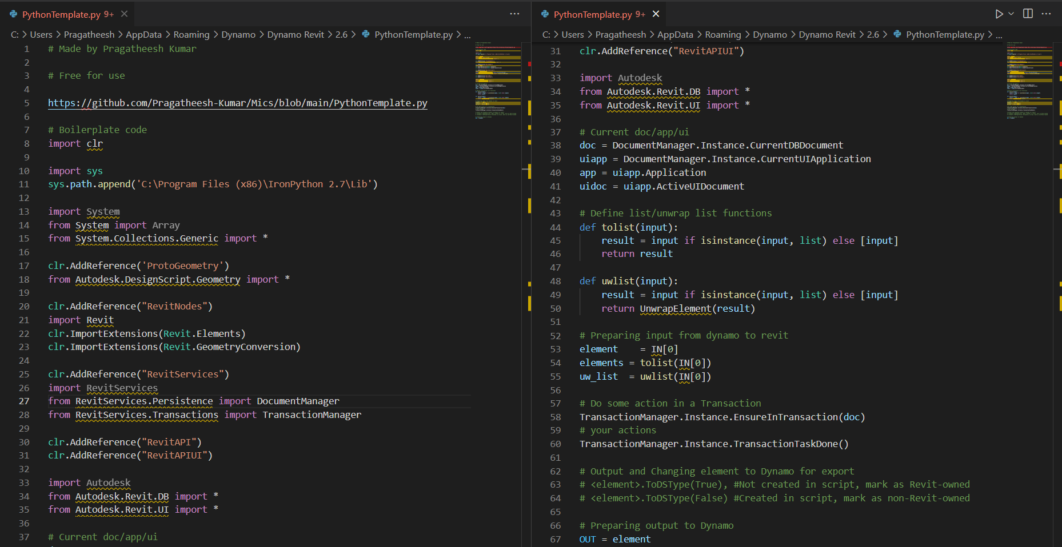
Woah… there is a lot here, Lets break this down!

Slide 15

clr = the library
Revit nodes
See it a bit like borrowing books from a library for an assignment.
Revit services
Revit API
Proto geometry

Slide 16




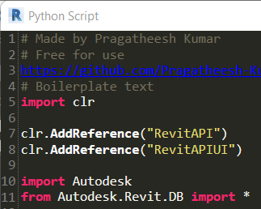
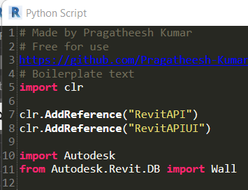
Important Try not to borrow a whole book!

Slide 17
Important, Don’t check out the whole library
You might not even need it!

Slide 18
CLR- COMMON LANGUAGE RUNTIME
import clr
Common language runtime:
Get it all started
Connects python and .net
Allows you to call on .dlls
Without this you really can’t get started, so it’s always necessary

Slide 19
Dll’s-Dynamic link libraries
They are a bit like instructions it’s like opening up a little manual that tells the program how to do something, so this is just a way that dynamo handles all of its methods that are stores outside of the Python shell.

Slide 20
Dll’s-Dynamic link libraries
‘Dynamic link libraries’ (dll’s)
Called on by code
Like pre-built ‘instruction’
C:\Program Files\Autodesk\ *Revit xxxx* \AddIns
\ DynamoForRevit
Root folder
Revit folder

Slide 21
USING EXTERNAL LIBRARIES
SYS.PATH
IronPython can access a whole bunch of modules that come with the IronPython Library as a bundled up with Dynamo. We need to tell Python to look here for the moduled. To do this, we need to append said path to the sys module as follows:
import sys
sys.path.append(r’C:\Program Files(*86)\IronPython 2.7\Lib’)

Slide 22
Revitnodes
clr.AddReference(“RevitNodes”)
import Revit
clr.importExtensions(Revit.Elements)
clr.importExtensions(Revit.GeometryConversion)
Reference the dll
Import Revit namespace
Add more element nodes
Add more geometry nodes

Slide 23
protogeometry
clr.AddReference(“ProtoGeometry”)
from Autodesk.DesignScript.Geometry import *
Reference the dll
Dynamo geometry classes
The protoGeometry library is usually required when you’re dealing with geometry and dynamo. It deals with all the preview geometry and all the geometry classes that dynamo is using. So this is quite common when you are dealing with points, lines, vectors, solids etc but if you are not dealing with geometry it is not necessarily required.

Slide 24
Revit api & revit apiui
clr.AddReference(“RevitAPI”)
clr.AddReference(“RevitAPIUI”)
import Autodesk
from Autodesk.Revit.DB import *
from Autodesk.Revit.UI import *
Reference the API dll’s
Import Autodesk namespace
Load Revit API Classes
Load Revit API UI Classes

Slide 25
Revit services
clr.AddReference(“RevitServices”)
import RevitService
from RevitServices.Persistence import DocumentManager
from RevitServices.Transaction import TransactionManager
Dynamo classes
Dynamo’s attentive document
Dynamo making changes to the Revit model (transactions)

Slide 26
Current document
doc = DocumentManager.Instance.CurrentDBDocument
And maybe
uiapp = Documentmanager.Instance.CurrentUIApplication
app = uiapp.Application
uidoc = uiapp.ActiveUIDocument
Current document
‘doc’ is now a variable

Slide 27
Transaction start/end
TransactionManager.Instance.EnsureInTransaction(doc)
# your actions
TransactionManager.Instance. TransactionTaskDone()
If changing Revit model
‘Checks out’ a spot in the db transaction queue
Usually near script end

Slide 28
Syntax Help !
dir(object)
Shows all available methods.
object.__doc__
Shows all documentation.

Slide 29
templating
C:\User\ *user name* \AddData
\Roaming\Dynamo\ Dynamo Revit\ *version*

Slide 30
Next on #2

Slide 31


Thank You
Pragatheesh kumar
Pragatheesh.kumar6@gmail.com

